Slide 1
Self-Activating Fall Alert
Department of Electrical and Computer Engineering
Hayley Langley and Sean Miller
Advisor: Dr. Imtiaz

Slide 2
Presentation Outline
Introduction
Our Solution
Results
Future Plans
Conclusion
Acknowledgements
References

Slide 3
Problem Statement
The amount of time it takes for a fallen senior citizen to receive help after a fall is considerable, and the current available solutions are not adequate in the event of a senior citizen being unconscious.

Slide 4
Significance and Motivation
Falls present a very serious issue for senior citizens with one fifth of all falls causing a serious injury[1].
Annually, 2.8 million people are seen in the emergency room for falls; 800,000 of those individuals require hospitalization for their fall related injuries.
Additionally, these falls cause serious injuries to senior citizens as 95 percent of hip fractures are caused from falling. These falls could also cause some sort of traumatic brain injury[1].

Slide 5
Significance and Motivation (Cont.)
Medical devices, such as Life Alert, naturally assume the user knows they are wearing the device, and have the ability to interact with it.
Every 11 seconds, an elderly person is treated in a hospital for a fall; every 19 minutes an elderly person dies from a fall related incident. [1]
About 28%(12.5 million) of non-institutionalized elderly citizens live alone.

Slide 6
Issues with Current Solutions
Not Having:
Fear of alarms systems due to it inappropriately going off or being difficult to maintain.
Having one:
The device is not practical in design, bulky and evident.
It is not self-activating which does not help when the elderly citizen is unconscious or forgets that they have one.
Fees:
Currently, all of the medical alert devices require a fee that is paid monthly for cellular charges

Slide 7
Our Proposed Solution
Our Self-Activating Device takes away the need for the elderly person to interact with the device to get the immediate help that is required. The self-activating fall alert device is a wearable system that is dependable, user-friendly, self-activating, and provides post-fall processing. The system aims to minimize the time to receive help after falling. The project aims to provide enough information from the data collection process to give to medical professionals who will be able to help with corrective measures for the wearer of the device. The device system aims to be able to make the distinguish between someone who has become unconscious and non-mobile due to a fall and someone who is just resting.

Slide 8
Objectives
Minimize time from fall to receiving help
Provide data for future corrective measures
Minimize battery consumption
More accurate detection of falls

Slide 9
Decision to Work on This Project
Team: A challenging project which utilizes and applies current engineering skills; as well as, broaden our engineering knowledge.
Individual:
Hayley: Passion for healthcare and the desire to help others
Sean: A strong belief that technology should be used to serve humanity

Slide 10
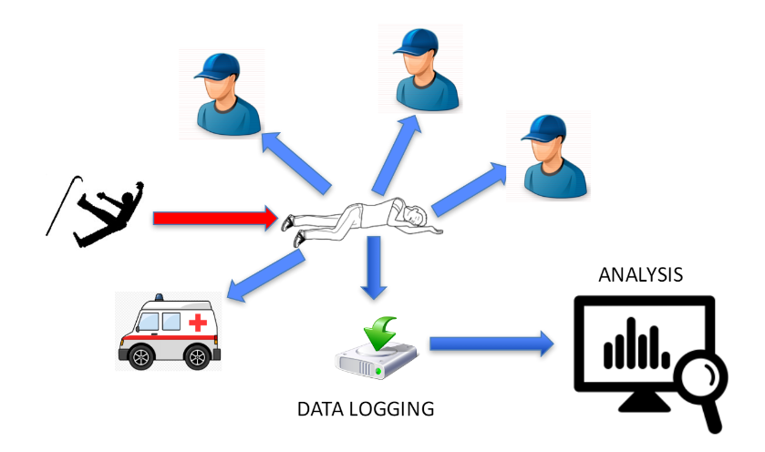
Design Process
Figure 1. Project Hierarchy Diagram

Slide 11
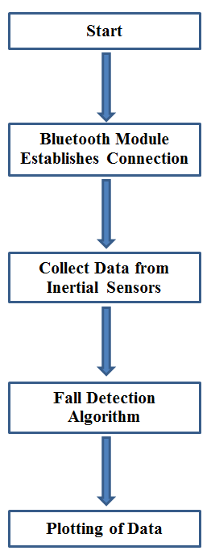
System Overview
Figure 2. System Overview

Slide 12
Design Constraints
Develop a compact, dependable, and self-activating system
Write device drivers that will accurately detect falls and eliminate false positives
Minimizes energy consumption
Maximizes battery life of the device

Slide 13
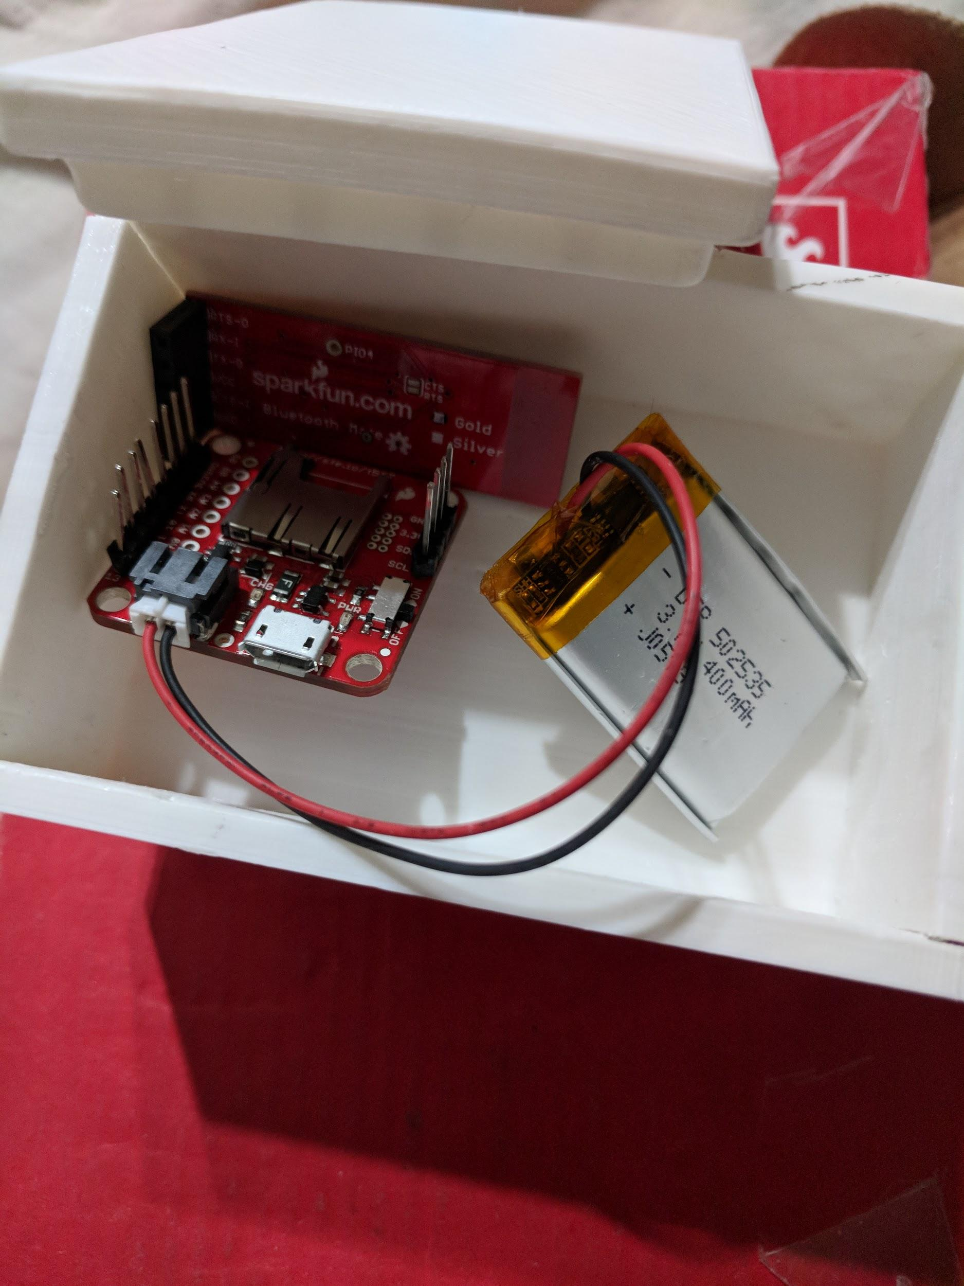
Parts List
SparkFun 9DoF(9 Degrees of Freedom) Razor IMU (Inertial Measurement Unit)
RN41 Bluetooth Mate Gold
Lithium Ion Battery
Figure 3. Device System and Case

Slide 14
Finances of the Project
PARTS | PRICE
SparkFun 9DoF Razor IMU | $34.95
RN41 Bluetooth Mate Gold | $34.95
Lithium Ion Battery | $4.95
Table 1. Parts and Price

Slide 15
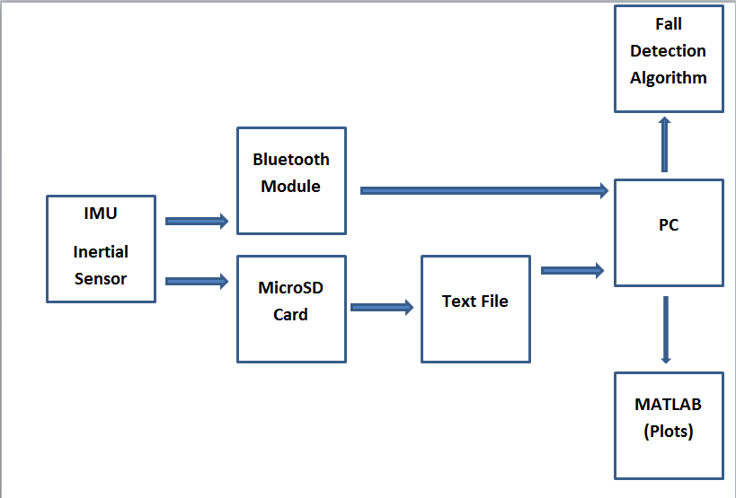
Software Block Diagram
Figure 4. Software Diagram

Slide 16
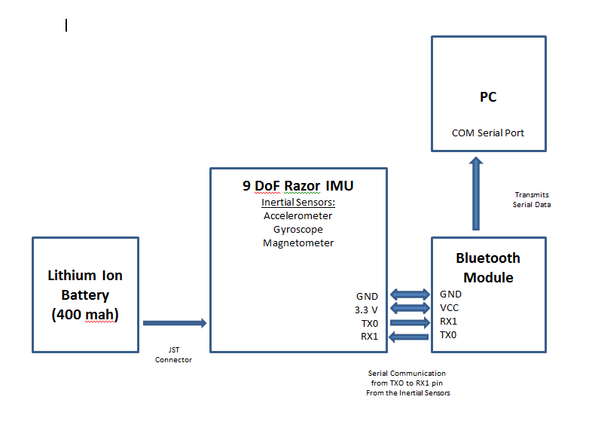
Hardware Block Diagram
Figure 5. Hardware Diagram

Slide 17
Design Approach - Fall Detection Algorithm
Determines that the acceleration of the data is higher during a fall
Determines that the fallen person is at rest after the fall
Monitors the magnetic field of the data
Experimental data used to determine the optimal parameters

Slide 18
Design Approach - Data Collection
Data is saved onto a microSD card
Format of data is time, accelerometer, gyroscope, magnetometer
Logs data before, after, and during the fall
Saved as LOG#.txt, where # represents a sequential number starting with 0

Slide 19
Design Approach - Post-Processing
Fourier Transform
Nyquist Frequency
Large D.C. component

Slide 20
Data Collection and Testing
Tapping on table
More accurate data collection
Tests include:
With and without falls
Sitting, Walking, Standing, Running, Laying, etc.

Slide 21
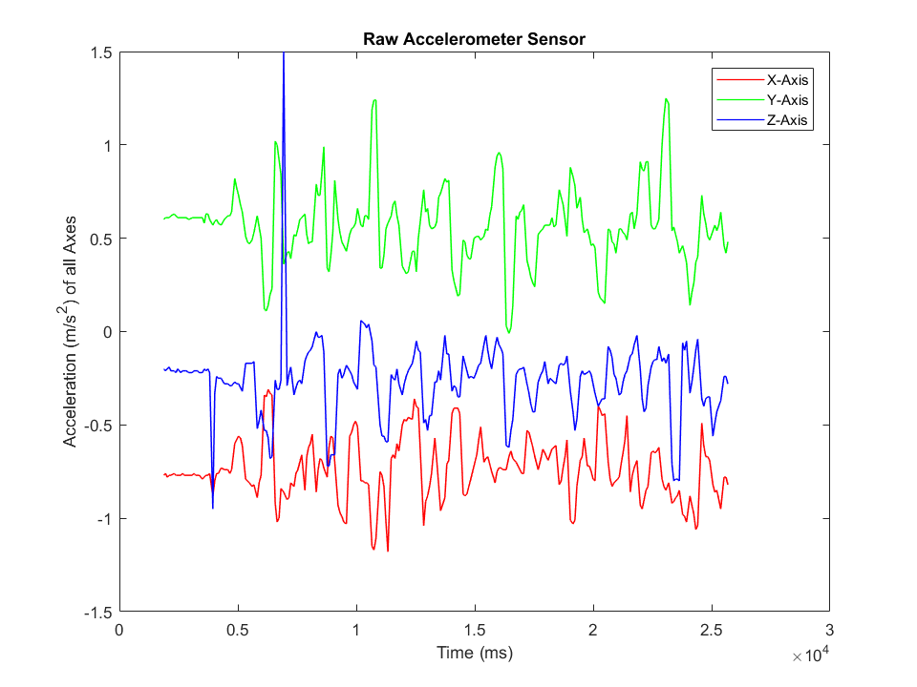
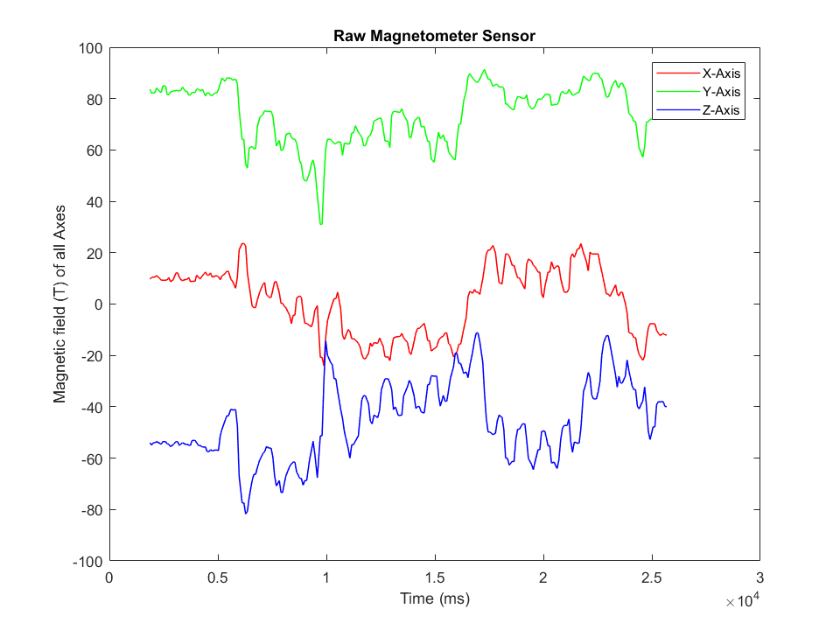
Data Collection - Walking
Figure 6. Raw Accelerometer Data
Figure 7. Raw Magnetometer Data

Slide 22
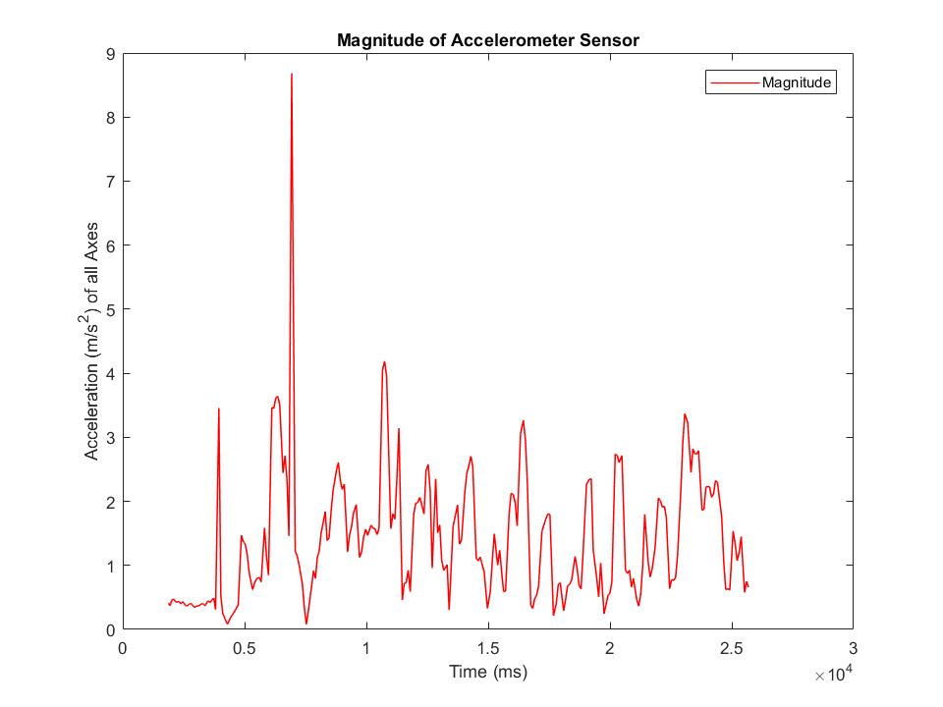
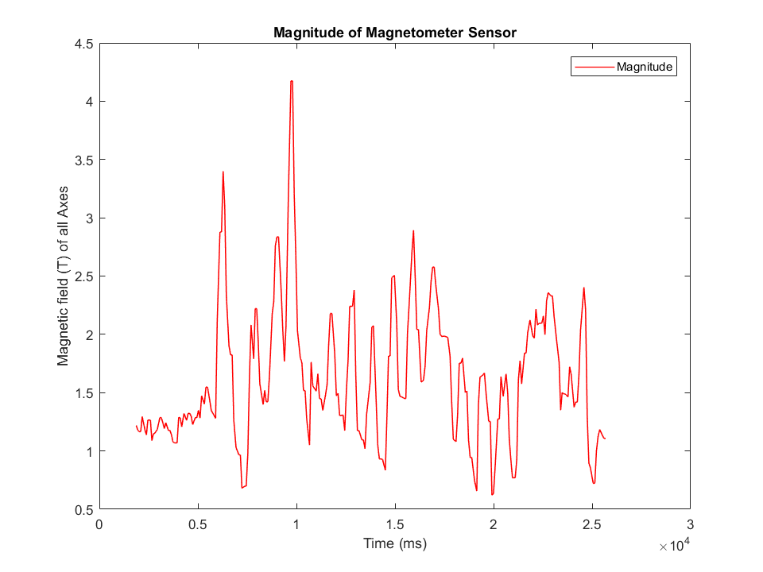
Data Collection - Walking
Figure 8. Magnitude of Accelerometer Data
Figure 9. Magnitude of Magnetometer Data

Slide 23
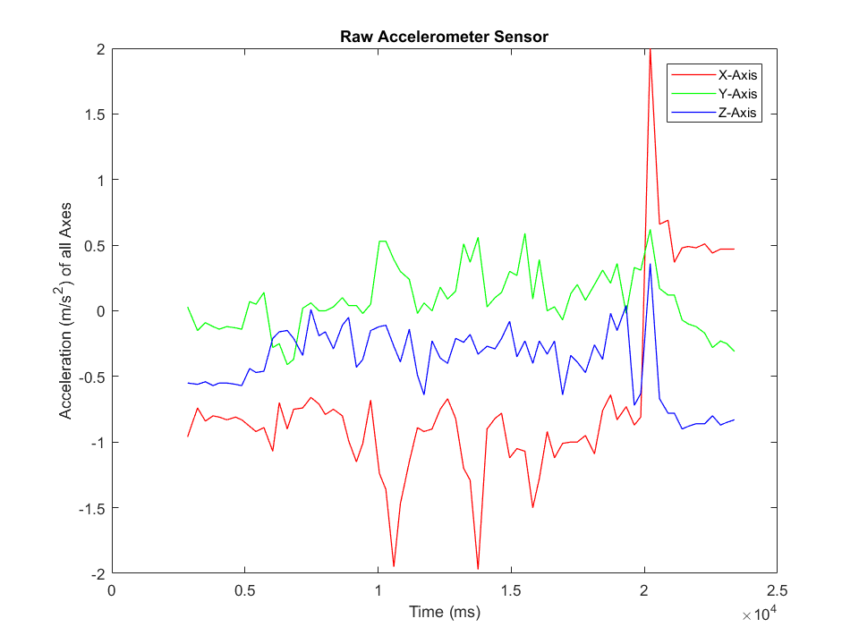
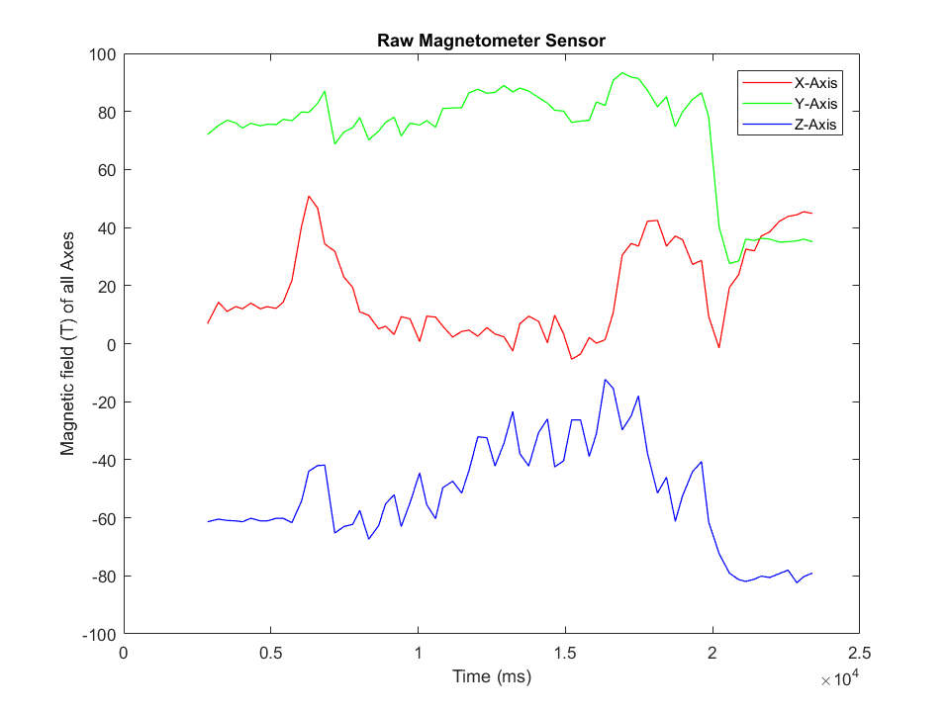
Data Collection - Walking with Fall
Figure 9. Raw Accelerometer Data
Figure 10. Raw Magnetometer Data

Slide 24
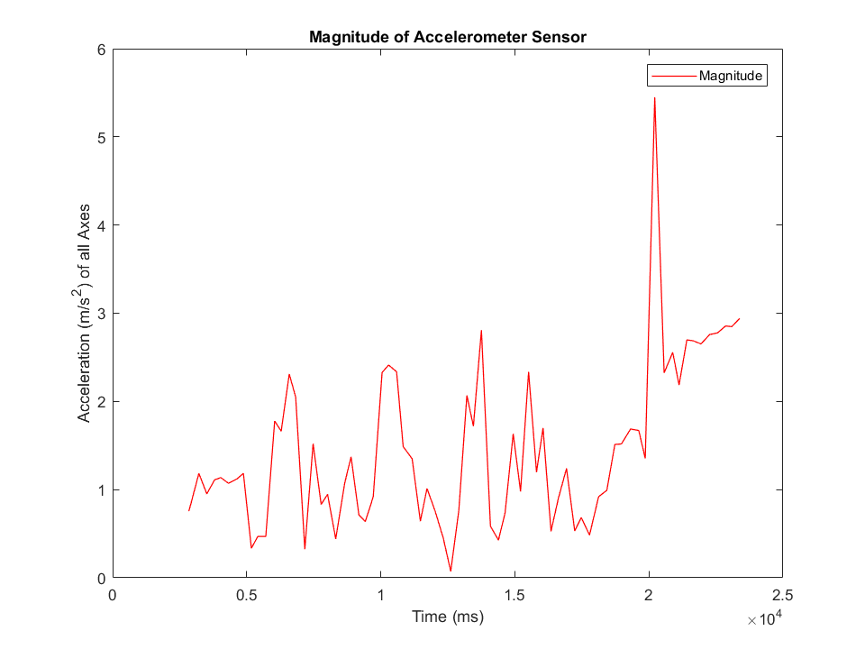
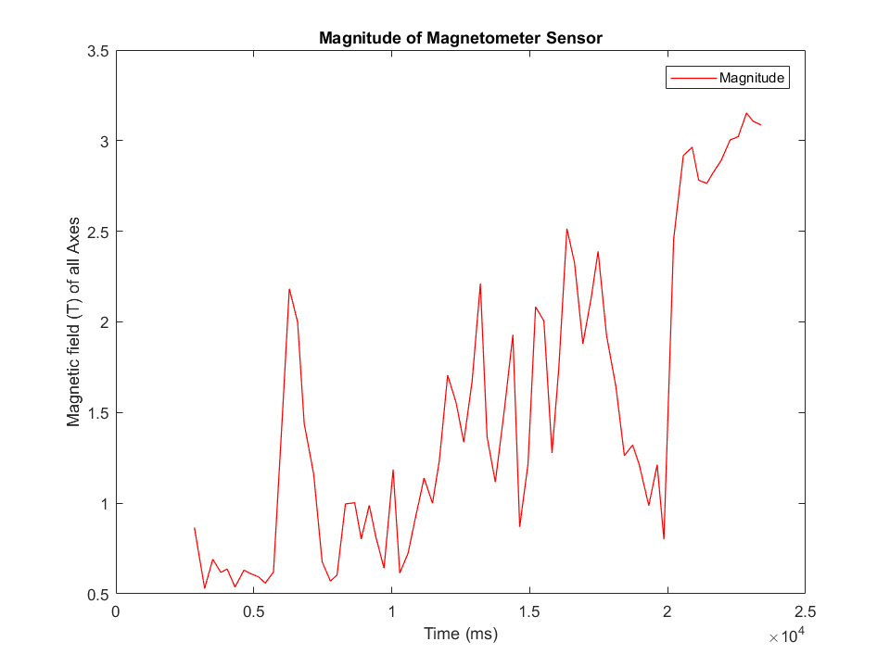
Data Collection - Walking with Fall
Figure 11. Magnitude of Accelerometer Data
Figure 12. Magnitude of Magnetometer Data

Slide 25
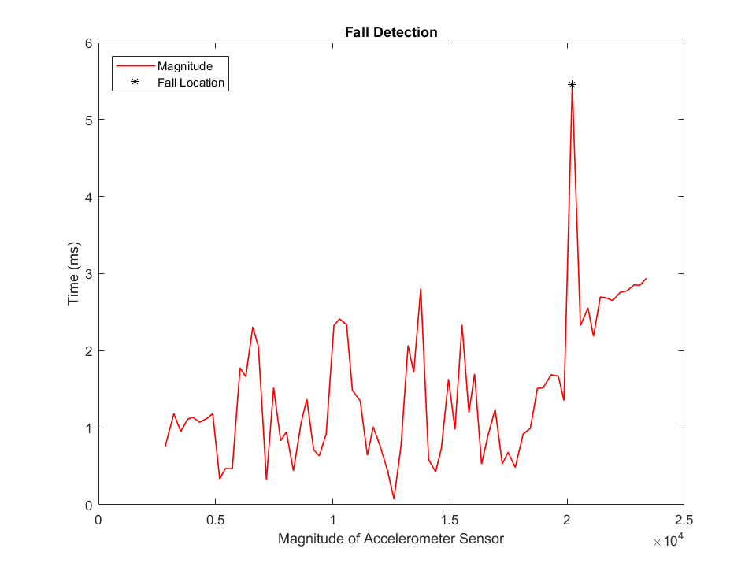
Fall Detection While Walking
Figure 13. Fall Detection

Slide 26
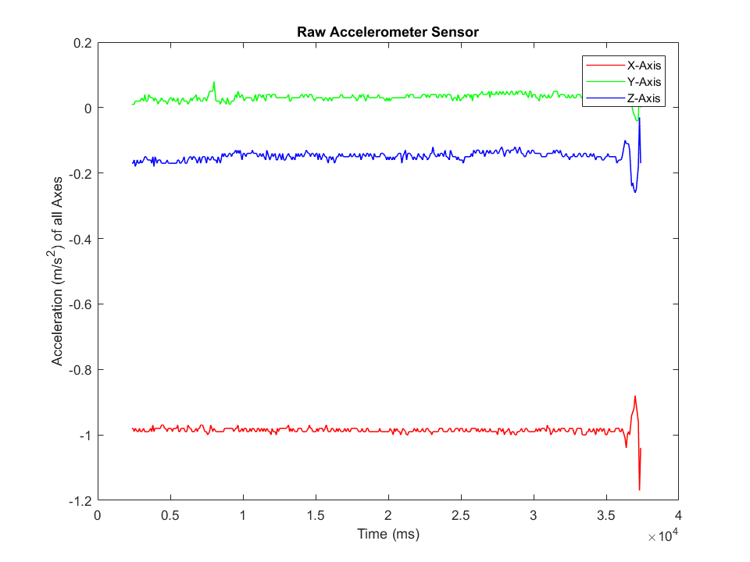
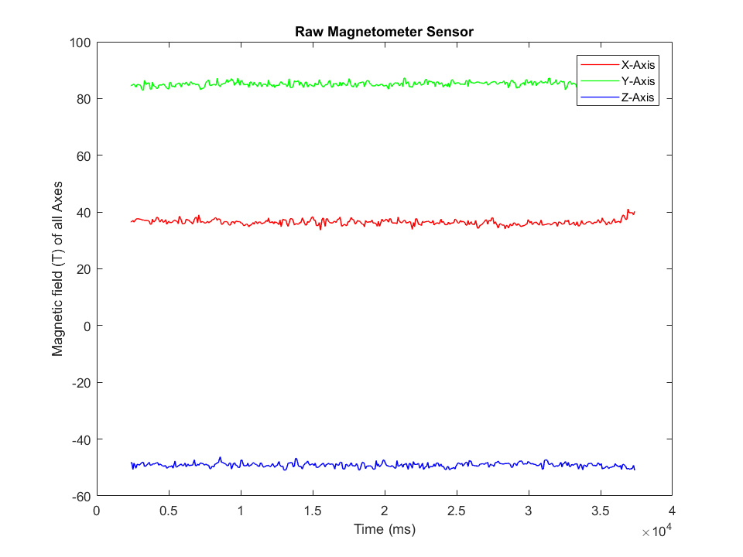
Data Collection - Standing
Figure 14. Raw Accelerometer Data
Figure 15. Raw Magnetometer Data

Slide 27
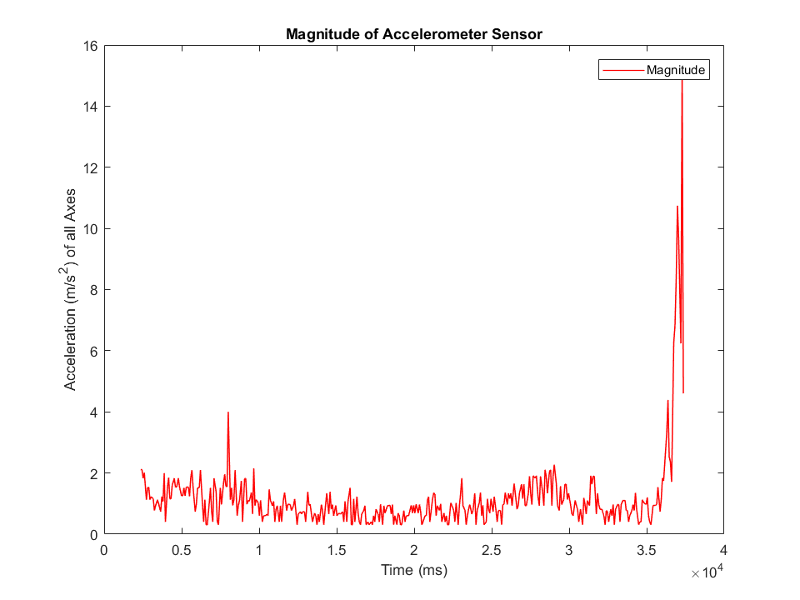
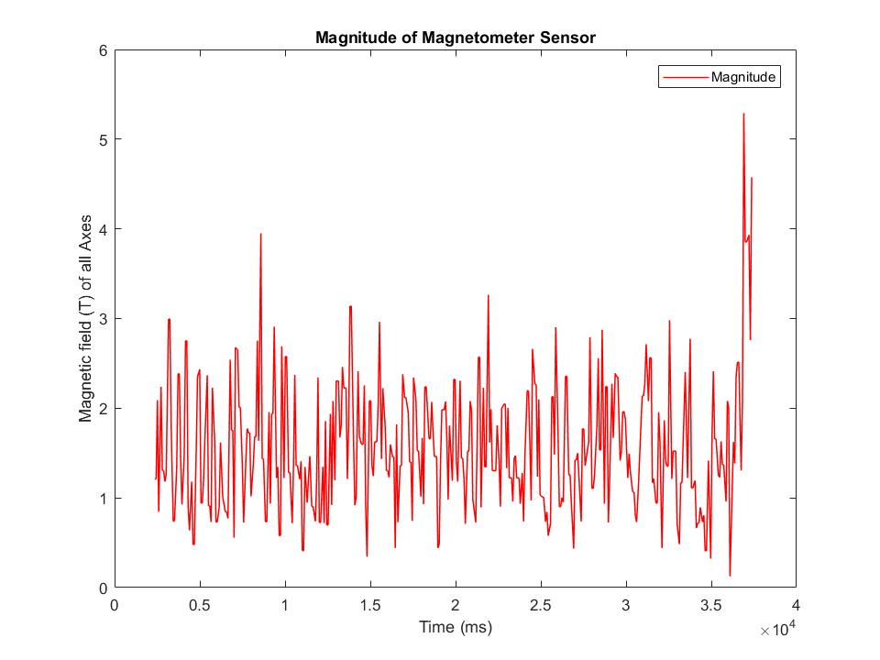
Data Collection - Standing
HAYLEY DO THIS
Figure 16. Magnitude of Accelerometer Data
Figure 17. Magnitude of Magnetometer Data

Slide 28
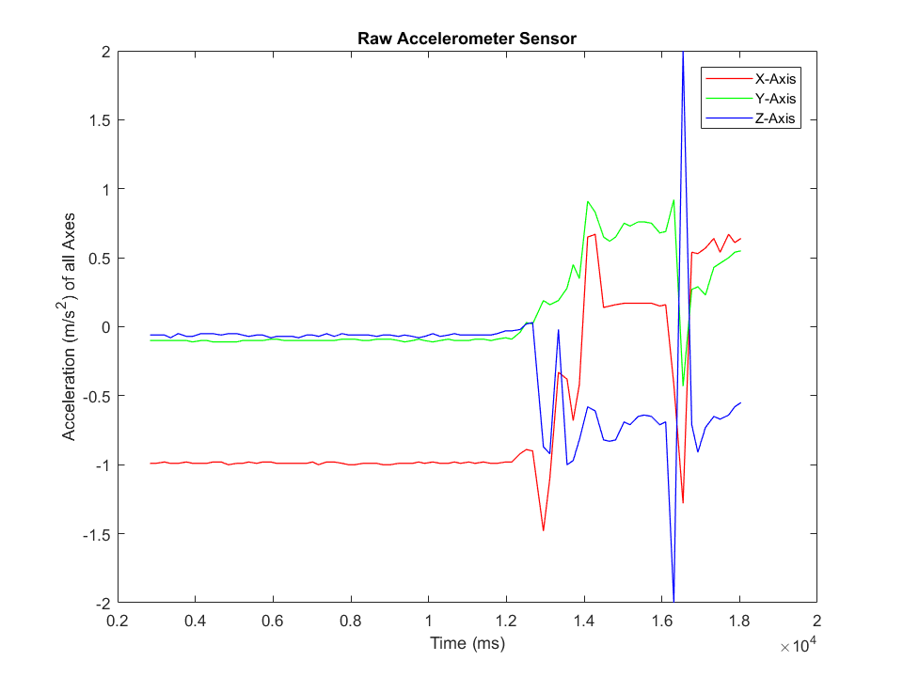
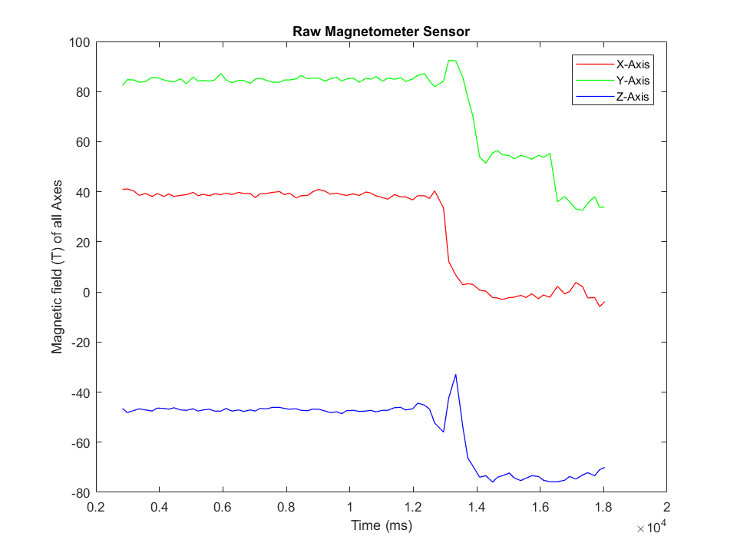
Data Collection - Standing With Fall
Figure 18. Raw Accelerometer Data
Figure 19. Raw Magnetometer Data

Slide 29
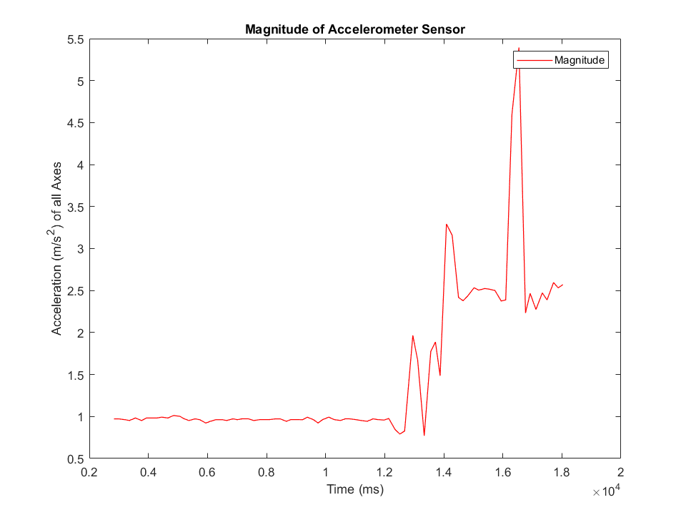
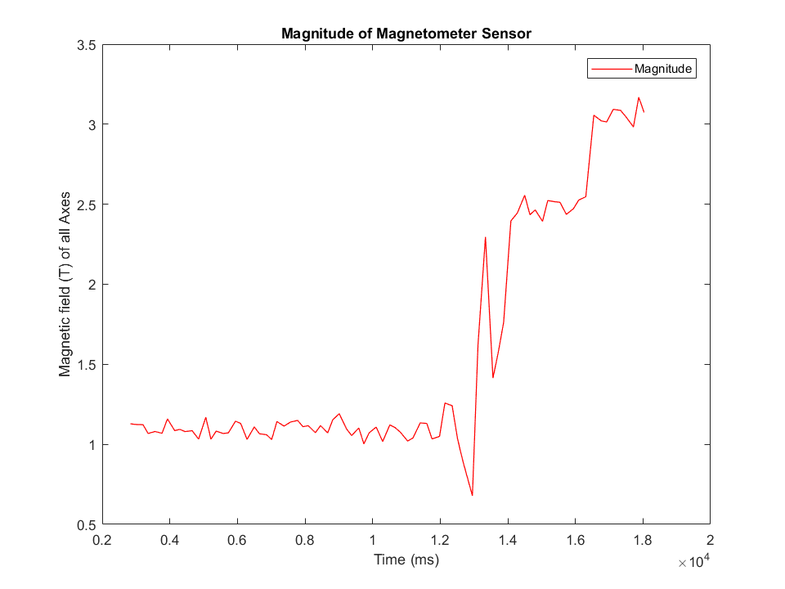
Data Collection - Sitting With Fall
Figure 20. Magnitude of Accelerometer Data
Figure 21. Magnitude of Magnetometer Data

Slide 30
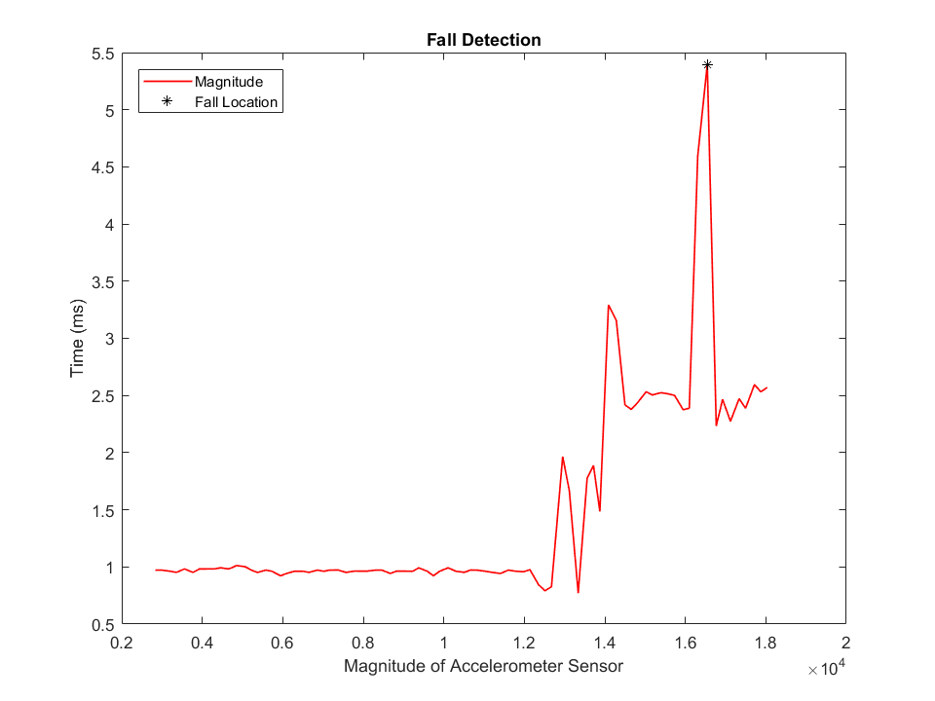
Fall Detection While Standing
Figure 22. Fall Detection

Slide 31
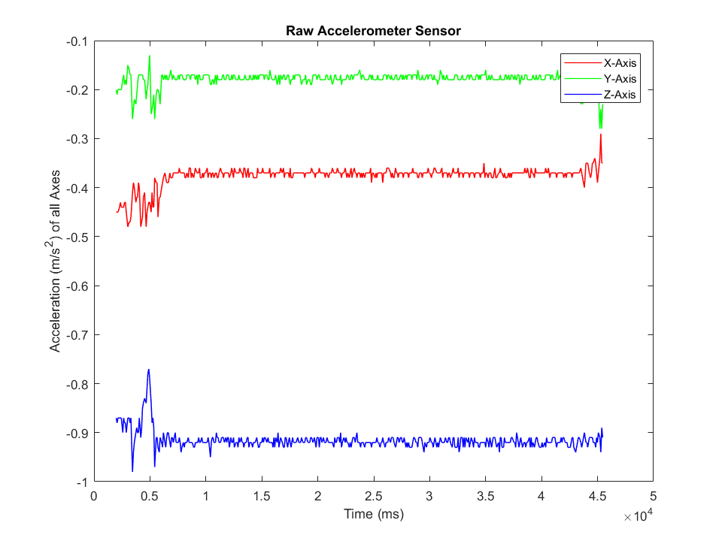
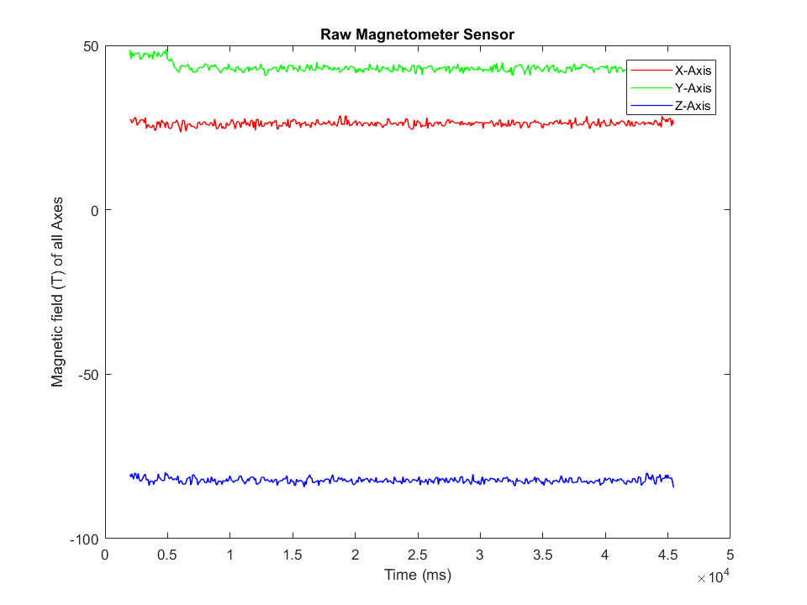
Data Collection - Sitting
HAYLEY DO THIS
Figure 23. Raw Accelerometer Data
Figure 24. Raw Magnetometer Data

Slide 32
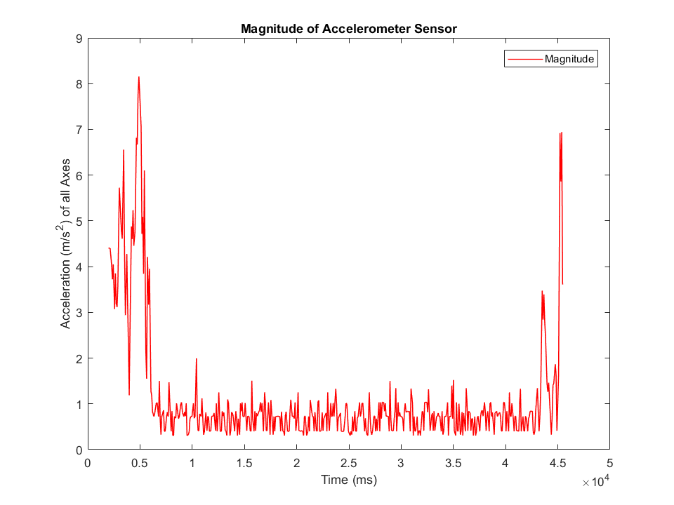
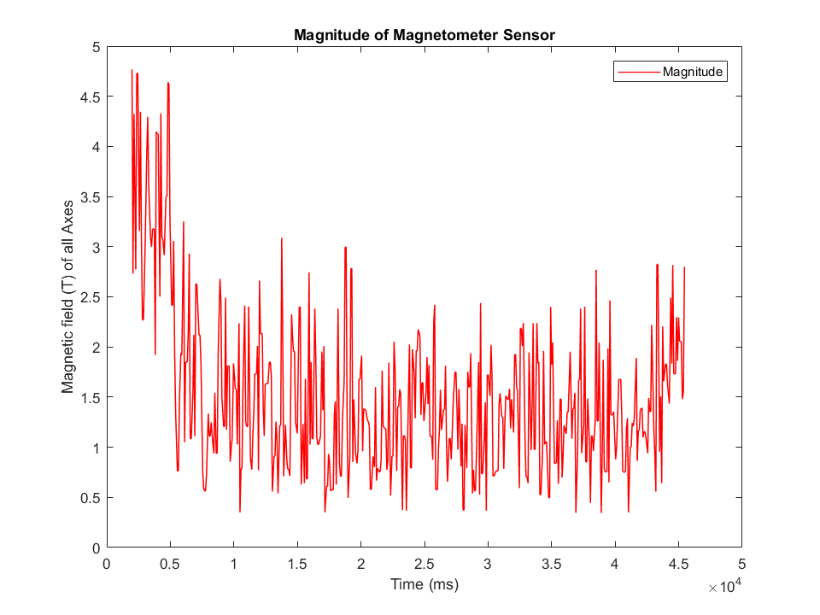
Data Collection - Sitting
Figure 25. Magnitude of Accelerometer Data
Figure 26. Magnitude of Magnetometer Data

Slide 33
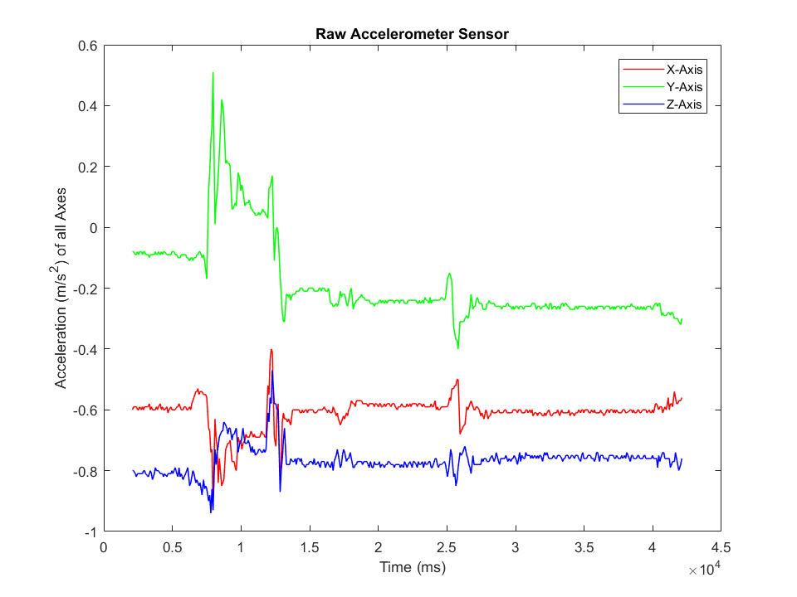
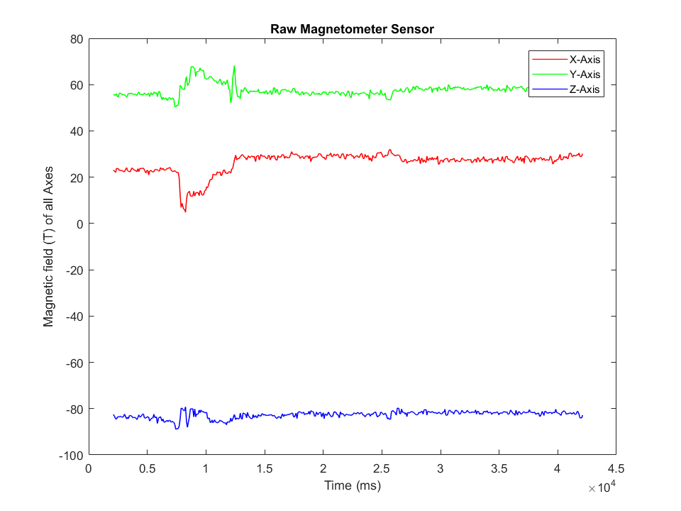
Data Collection - Sitting with Minimal Movement
Figure 27. Raw Accelerometer Data
Figure 28. Raw Magnetometer Data

Slide 34
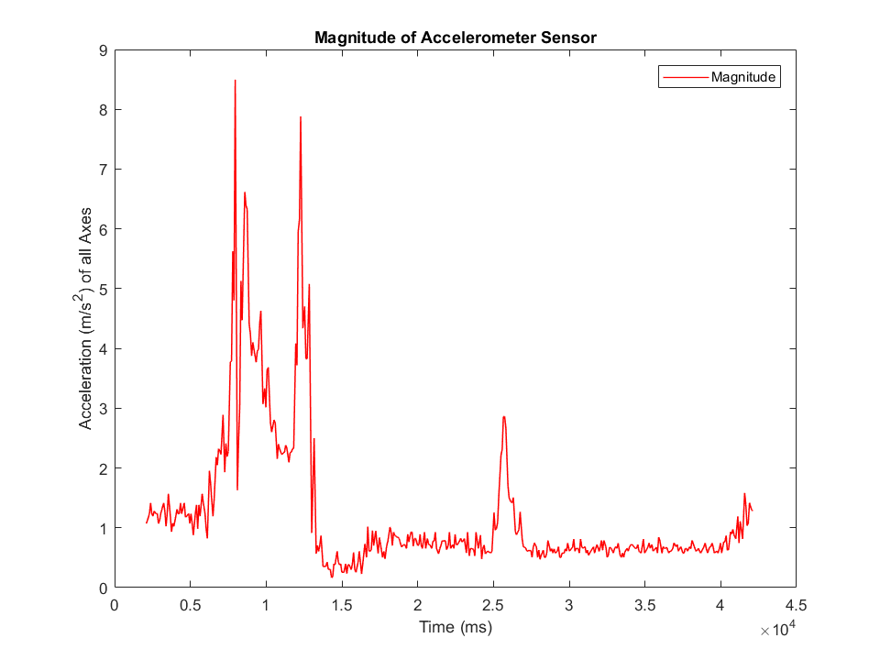
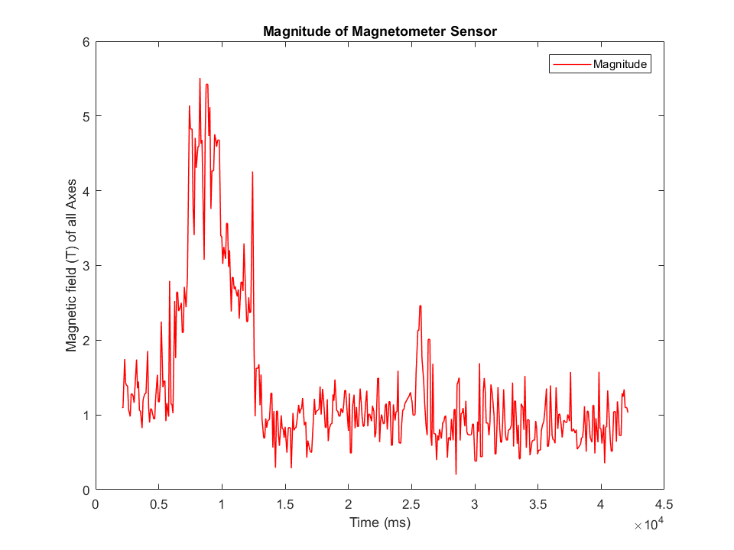
Data Collection - Sitting with Minimal Movement
Figure 29. Magnitude of Accelerometer Data
Figure 30. Magnitude of Magnetometer Data

Slide 35
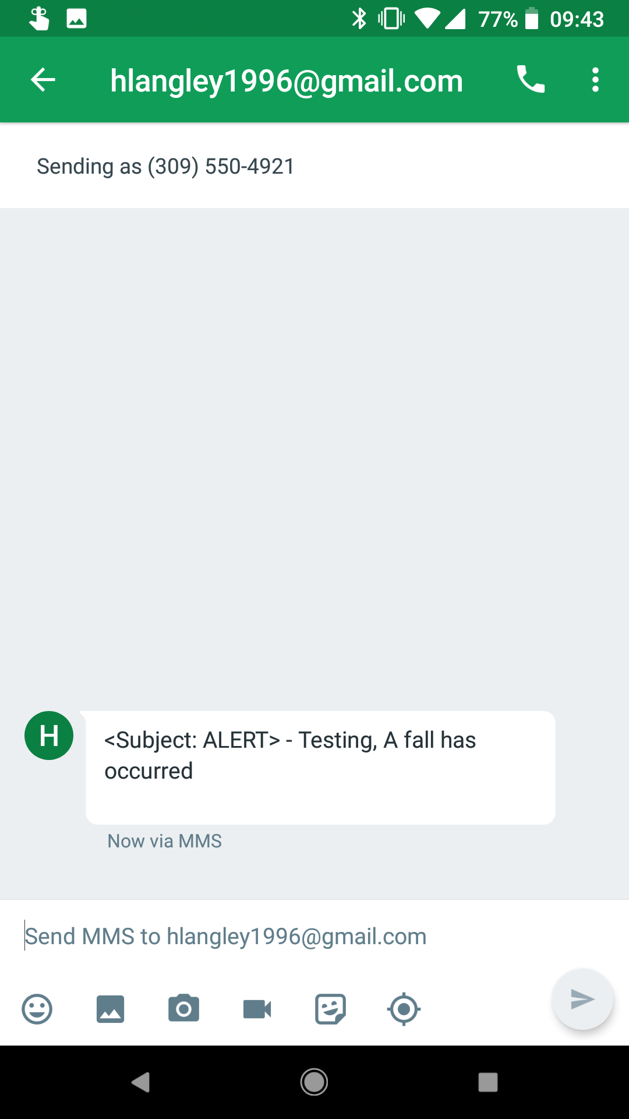
Post Analysis Demonstration
Figure 31. Fall Alert Text
Video 1. Post Analysis Demonstration

Slide 36
Preliminary Results
Magnetometer works great
Spike in the field
High fall detection rate

Slide 37
Differences Between Last Year and This Year
Increased battery life
Decreased false positives
Decreased device size

Slide 38
Skills Learned
Hayley: Proper documentation makes group projects easier, management of deadlines, distribution of work equally among a team
Sean: A spirit of cooperation, and artificial intelligence

Slide 39
Difficulties
Hayley: Generating test data, accurate data readings, transmitting data over Bluetooth
Sean: Communication, due to different coding preferences and habits

Slide 40
Conclusion
Elimination of false positives in the fall detection algorithm
Increased battery life
The size of the device has been minimized
Attachable case for device
Effectively allocate biometric data for future research

Slide 41
Suggestions for Next Group
Wi-Fi
Add a central data station
Have a manual option
Add in detection of the device being dropped

Slide 42
Acknowledgements
Mr. Mattus
Mr. Schmidt
Dr. Imtiaz
All you lovely people

Slide 43
Questions?

Slide 44
References
[1] “Important Facts about Falls | Home and Recreational Safety | CDC Injury Center.” [Online]. Available: https://www.cdc.gov/homeandrecreationalsafety/falls/adultfalls.html. [Accessed: 16-Nov-2017].
[2] “Latest Alzheimer’s Facts and Figures,” Latest Facts & Figures Report | Alzheimer’s Association, 17-Sep-2013. [Online]. Available: //www.alz.org/facts/overview.asp. [Accessed: 16-Nov-2017].
[3] FallAlert2017, Contribute to Self-Activating-Fall-Alert development by creating an account on GitHub. 2017.
[4]“9DoF Razor IMU M0 Hookup Guide - learn.sparkfun.com.” [Online]. Available: https://learn.sparkfun.com/tutorials/9dof-razor-imu-m0-hookup-guide. [Accessed: 27-Apr-2018].

